Slide 1

It’s a ’climate changed’ snake
National University of Science and Technology POLITEHNICA of Bucharest
Development of a Gamified Learning Application for Acquiring Knowledge on Climate Change

Slide 2
Table of contents
01
02
03
04
05
06
Introduction
Implemenation
Development Stages
Difficulties
Code Breakdown
Improvements

Slide 3

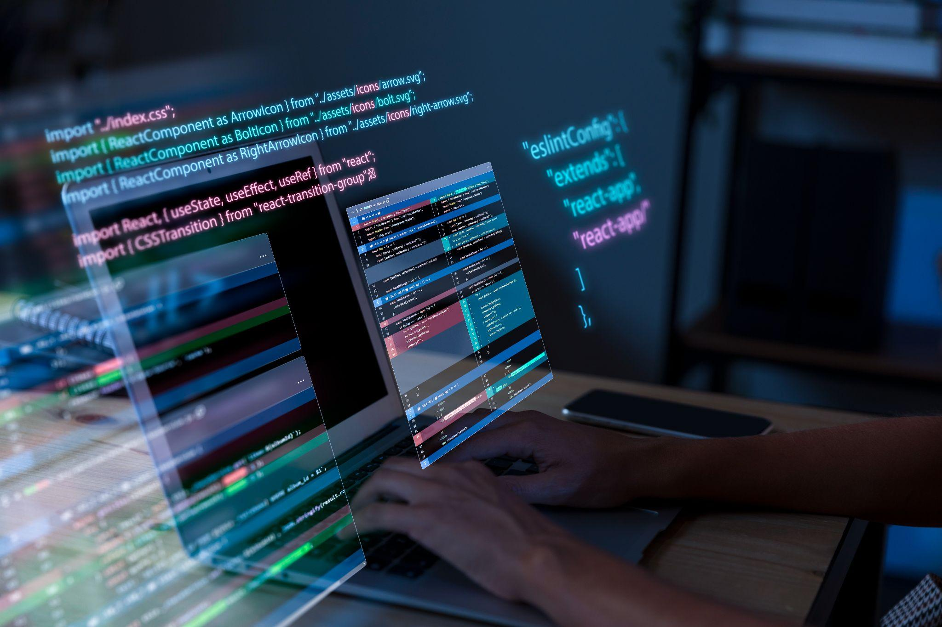

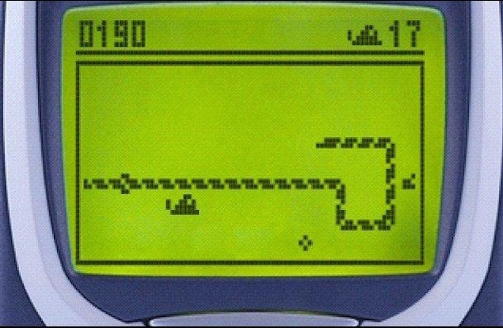
Introduction
The primary objective of this project is to enhance awareness and understanding of climate change among users through a gamified learning platform.
Based on the old Snake Game we tried to motivate users to adopt sustainable practices in their daily lives, promote collaboration and community engagement.

Slide 4

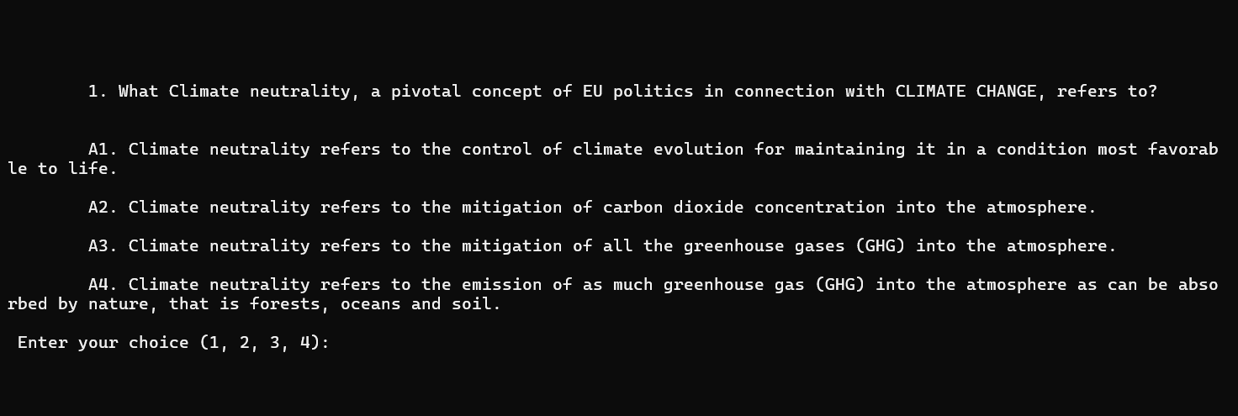
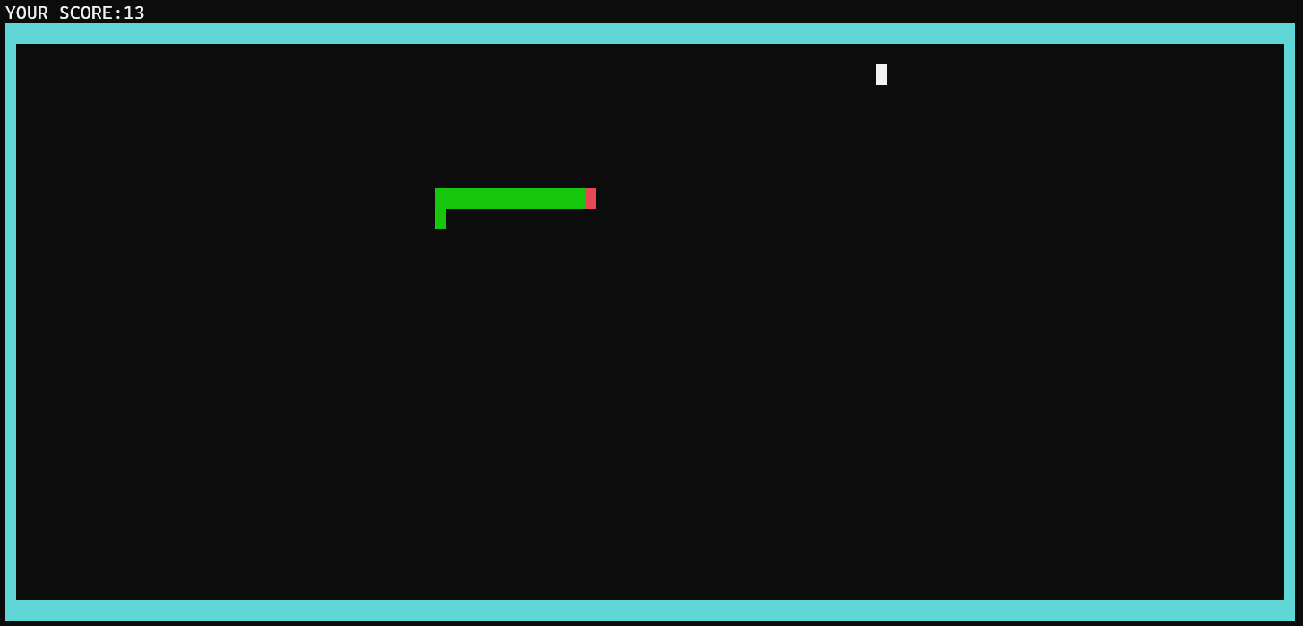
Implementation
The project involves developing a quiz integrated with a Snake game, both implemented in C++. After you are done with the questions of the quiz, every correct answer will give you a 2 point advantage in the game afterwards.
The Quiz
The game

Slide 5

Development Stages
Designing the Quiz Implementation
Developing the Snake Game
Plan how the quiz elements will be integrated into the Snake game.
Create a basic version of the Snake game to establish core mechanics.
Debugging
Enhancements
Conduct thorough testing to identify and resolve bugs and issues.
Optimize performance and user experience

Slide 6

Clear Screen Mechanisms -system("cls") function-
Difficulties
Managing different screen resolutions to ensure the game and quiz display correctly

Slide 7

Code Breakdown
Code Flow Start with Quiz -> Transition to Snake Game --> Game Loop -> Game Over and Restart
Key Components and Functions
Namespace Definitions
Board Class
setcursor(): Positions the cursor
print_title(): Displays the game
print_highscore()
Console Colors: define various color codes for text and background.
Classes
Handles console color settings, cursor positioning, and displays various message
Snake Class
initialise_snake()
move_snake()
eat_food()
Global Variables
Score Management: score tracks the user's score throughout the quiz and game.

Slide 8


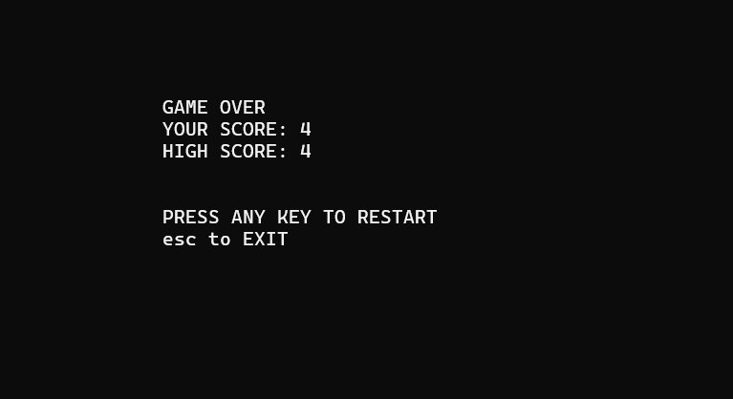
Conclusions
Students
MIRCU Daniel-Ioan
BALU Adrian-David
PETRE Horia-Ioan
NICOLAE Tudor-Ștefan
PETRUȚIU Darius-Simion
IORDACHE Robert-Georgian
Through the innovative adaptation of the classic Snake Game, our project successfully increased awareness and understanding of climate change. By incorporating gamification, we motivated users to adopt sustainable practices, fostered collaboration, and promoted community engagement.

Slide 9
Bibliography
https://www.gadgets360.com/apps/news/popular-mobile-game-snake-is-coming-back-689482
https://letstalkscience.ca/educational-resources/backgrounders/introduction-climate-change

